Slide 1

STM32 Workshop
Session 2
By Moktar SELLAMI

Slide 2
Plan
1
5
2
6
3
7
4
Quiz
HAL APIs
Setup ST account
Blinking an LED
STM32Cube IDE Installation
Reading Button state
HAL

Slide 3
Quiz

Slide 4
Quiz
1. What does GPIO stand for?
A) General Processor Input/Output
B) General Purpose Input/Output
C) Generic Port Input/Output
D) General Programmable Input/Output

Slide 5
Quiz
2. On an STM32 microcontroller, how are GPIO pins grouped?
A) Into clusters called PORTS (e.g., GPIOA, GPIOB)
B) Into clusters called BANKS
C) Into clusters called MODULES
D) Into clusters called UNIT

Slide 6
Quiz
3. If an internal green LED is connected to "PD12" meaning:
A) It is connected to Peripheral Device 12.
B) It is connected to Pin Diagram 12
C) It is connected to Power Domain 12.
D) It is connected to Port D, Pin 12..

Slide 7
Quiz
4. Which of the following is NOT one of the four main GPIO modes on an STM32?
A) Input
B) Output
C) Analog
D) Serial
E) Alternate Function

Slide 8
Quiz
5. In a GPIO output configuration, what is a key characteristic of the "Push-Pull" mode?
A) It can only sink current, connecting the pin to ground for a logic low.
B) It uses an external resistor to pull the line high when inactive.
C) It can actively drive the pin both high (to VCC) and low (to GND).
D) It is used exclusively for analog signals like audio.

Slide 9
Quiz
6. Why is an internal "Pull-Up" resistor often used with a GPIO pin configured as an input?
A) To increase the pin's output current for driving an LED.
B) To set a known default logic state (high) when no external signal is present.
C) To convert the pin into an analog input for a sensor.
D) To protect the pin from electrostatic discharge (ESD).

Slide 10
Quiz
7. In the context of STM32's HAL, which functions would you use to change the state of an LED ?
A) HAL_GPIO_ReadPin()
B) HAL_GPIO_WritePin()
C) HAL_GPIO_TogglePin()
D) HAL_GPIO_LockPin()

Slide 11
Quiz
Answers:
1 - B
2- A
3- D
4 - D
5- C
6- B
7 - B & C

Slide 12
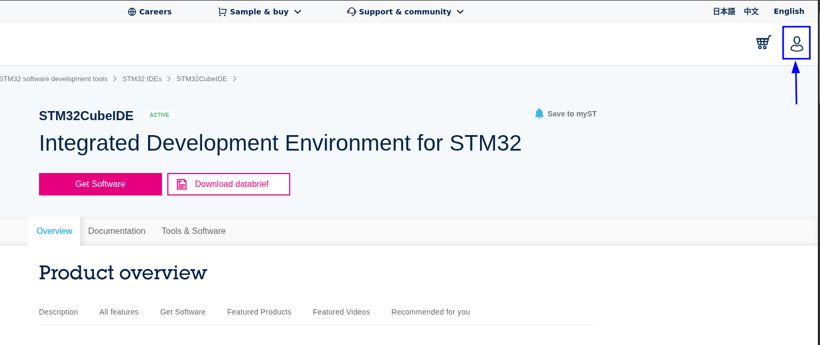
Setting up the Environment: STM32 CubeIDE
0- You need a lot of patience.
1- Go this link and create a account, you will get an email verification.

Slide 13
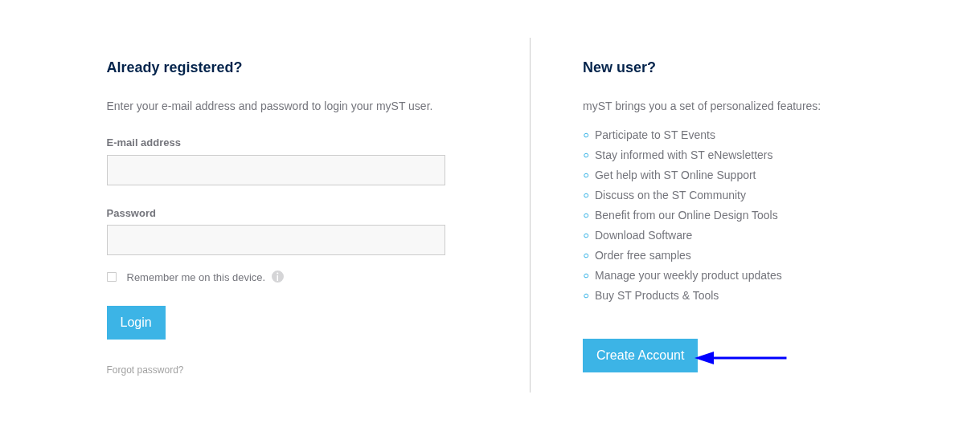
Setting up the Environment: STM32 CubeIDE
2- Create the account, fill in the necessary information
Fill in only the necessary info that are indicated with *

Slide 14
Setting up the Environment: STM32 CubeIDE
3- After some time you will receive and email of verification, verify it and your St account should be created.

Slide 15
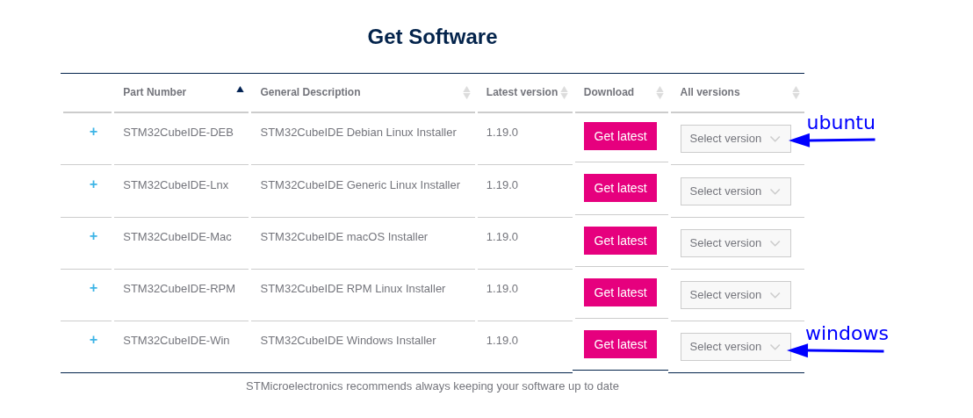
Setting up the Environment: STM32 CubeIDE
4- Go this link again and download the Latest STM32 CubeIDE version
I

Slide 16
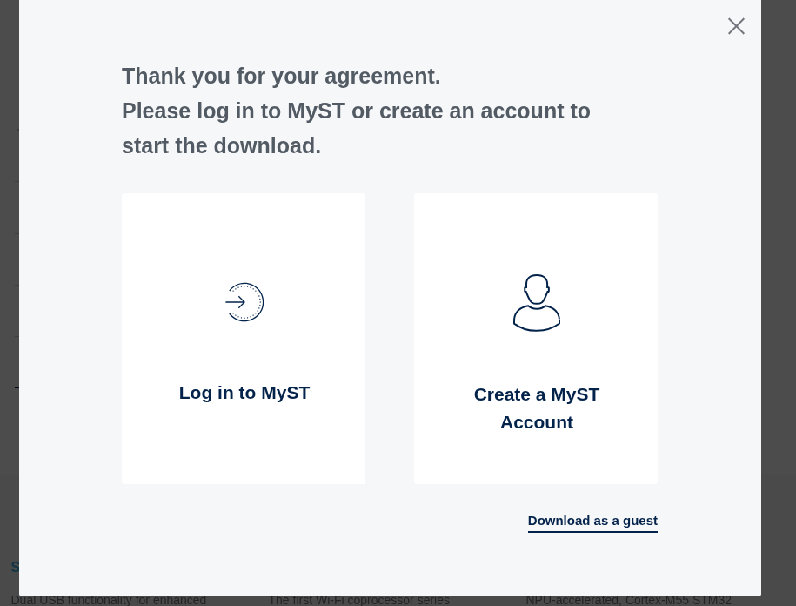
Setting up the Environment: STM32 CubeIDE
5- Accept to the Licence agreement
6- It i will prompt you to Login or use a guest choose Log in to MyST
Note:
We create an account because, CubeIDE requires it sometimes

Slide 17
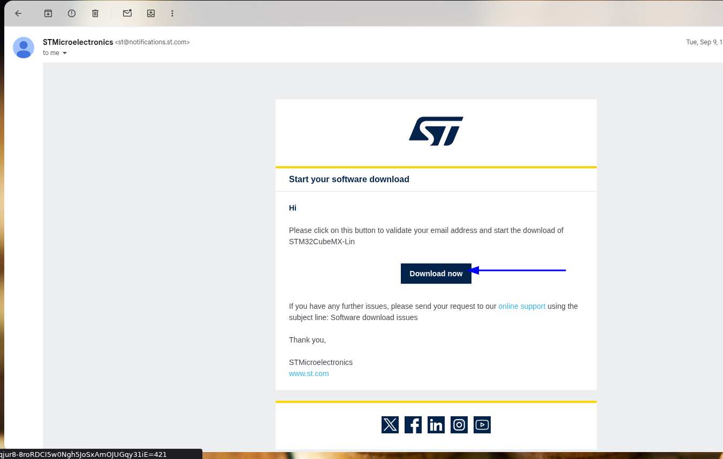
Setting up the Environment: STM32 CubeIDE
7- An Email should be sent to you, give it some time .
I

Slide 18
Setting up the Environment: STM32 CubeIDE
8- it will open a new session on you browser and hopefully, is will start downloading
Note:
In case it didn't start, restart the downloading process.
I

Slide 19
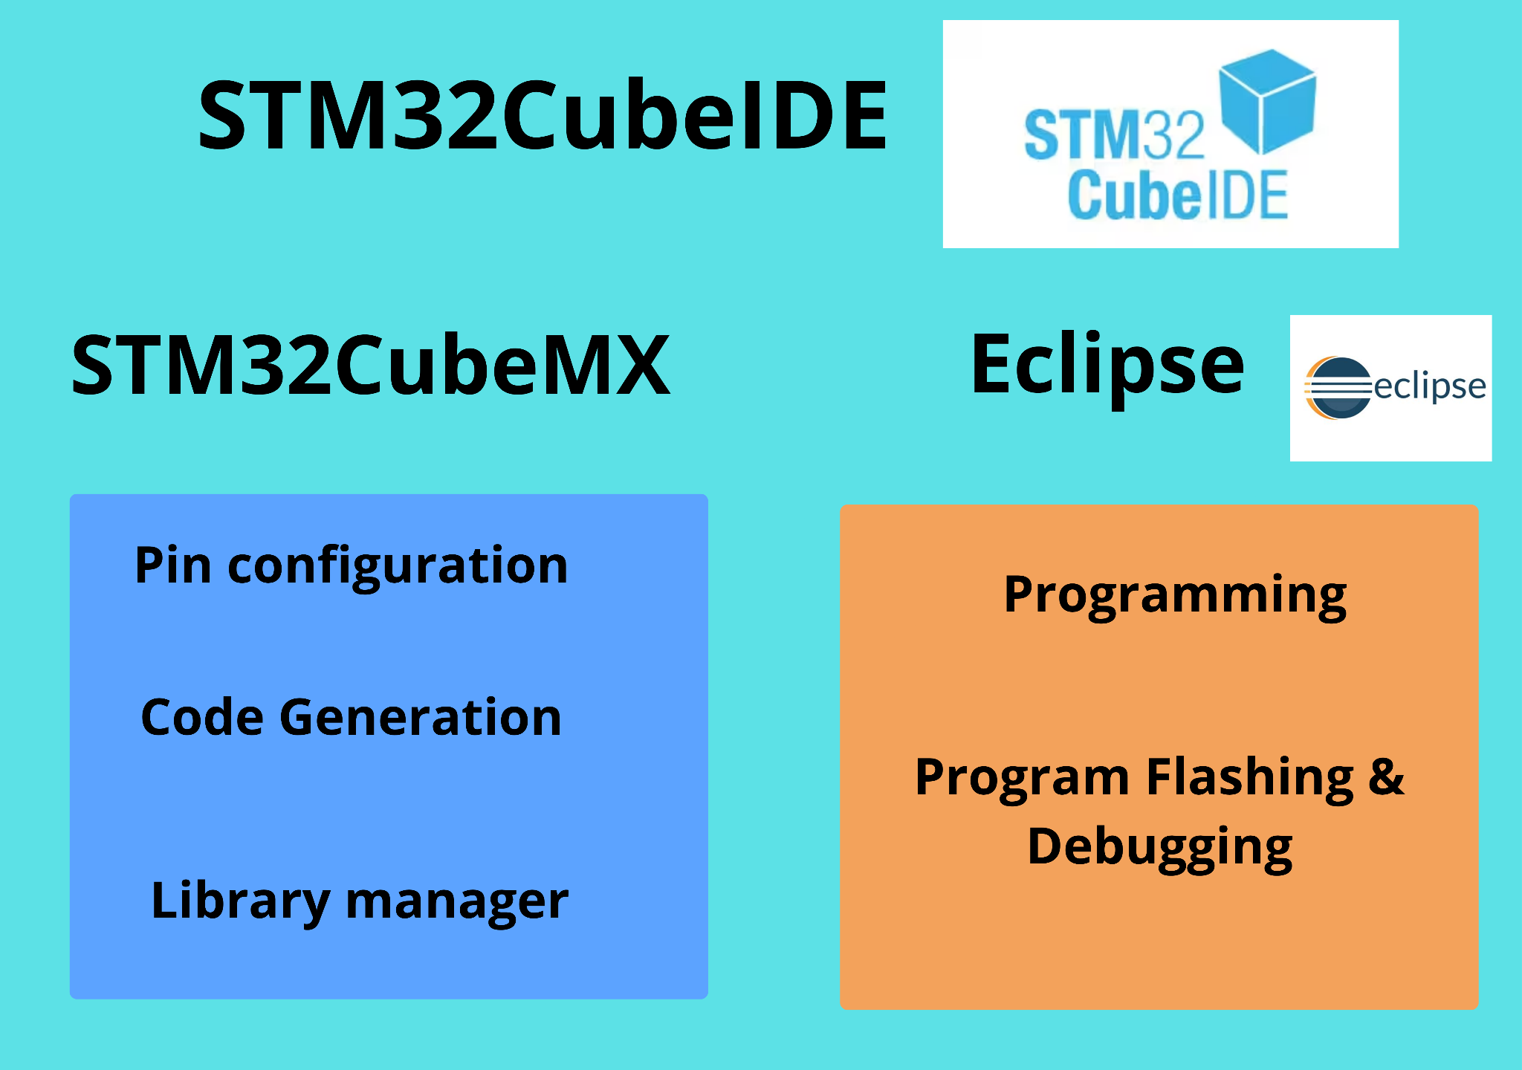
STM32Cube IDE

Slide 20
STM32Cube IDE

Slide 21
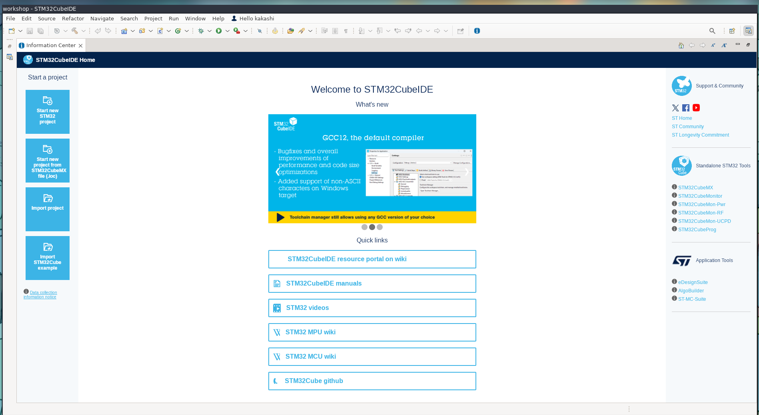
STM32Cube IDE: new project
I

Slide 22
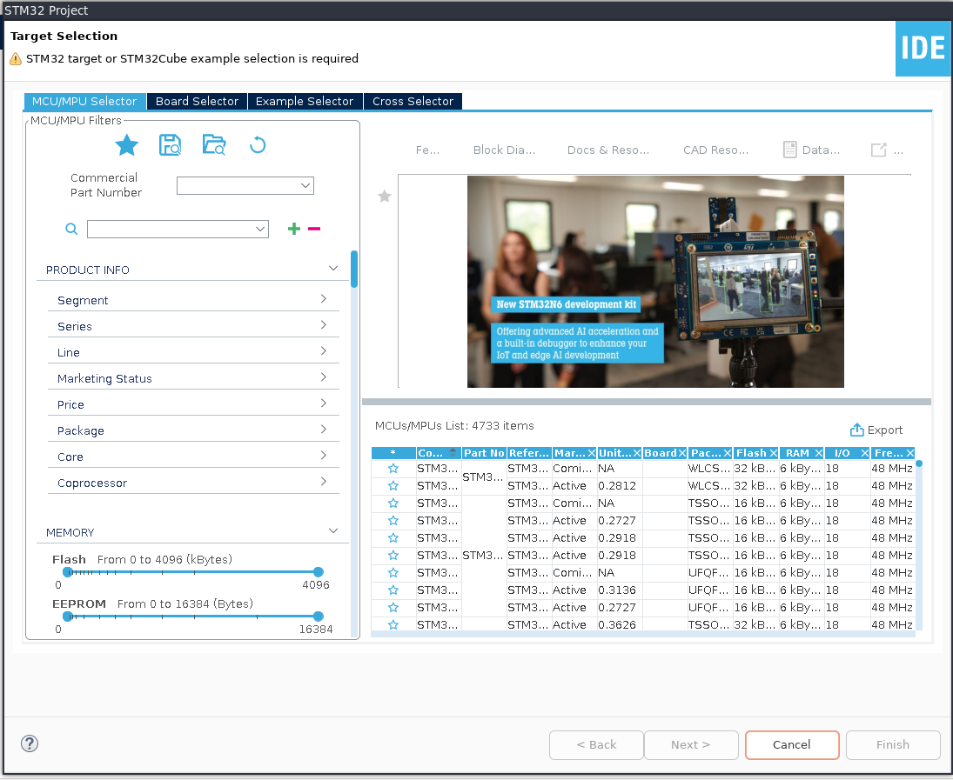
STM32Cube IDE: select target
I

Slide 23
STM32Cube IDE: Creating the project
I

Slide 24
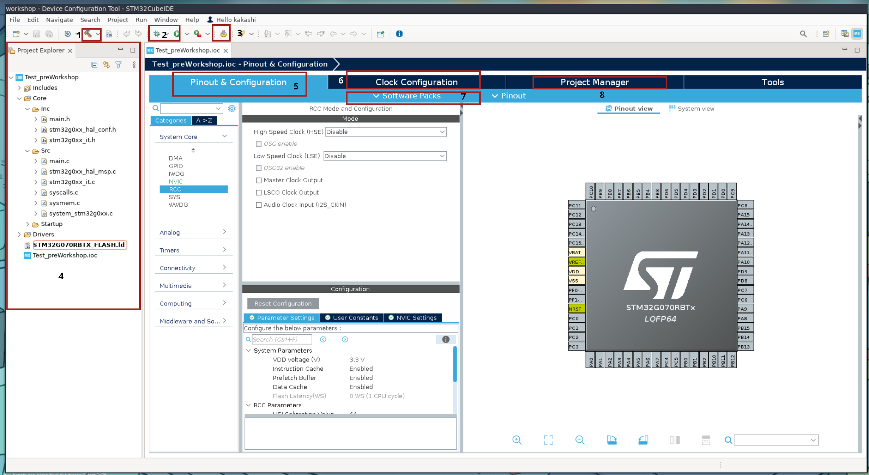
STM32Cube IDE: Creating the project
I

Slide 25
STM32Cube IDE: Creating the project
1- Build
2- Run & debug
3- Generate code
4- Project structure
5- Pinout config
6- clock config
7- Software packs
8- Project manager

Slide 26
HAL
HAL is a software layer provided by STMicroelectronics that abstracts the hardware details of STM32 microcontrollers.
It provides a standardized set of functions to interact with peripherals (GPIO, UART, I2C, etc.) regardless of the specific STM32 chip you're using.

Slide 27
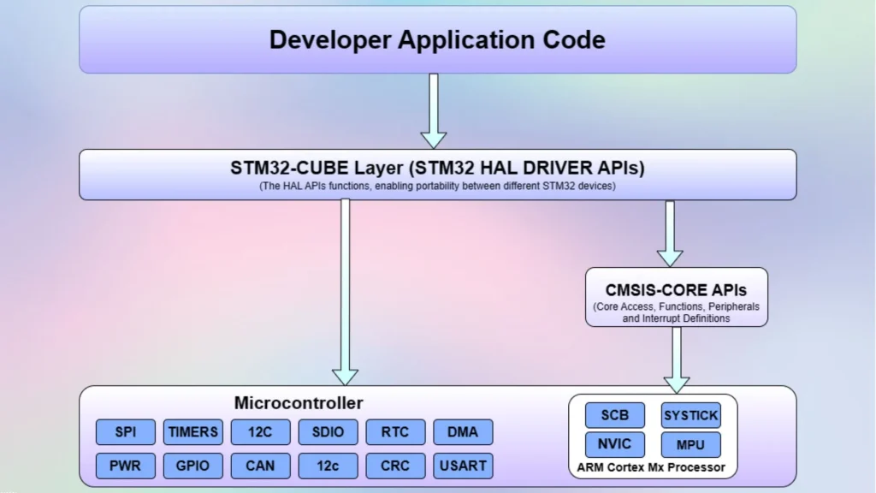
HAL

Slide 28
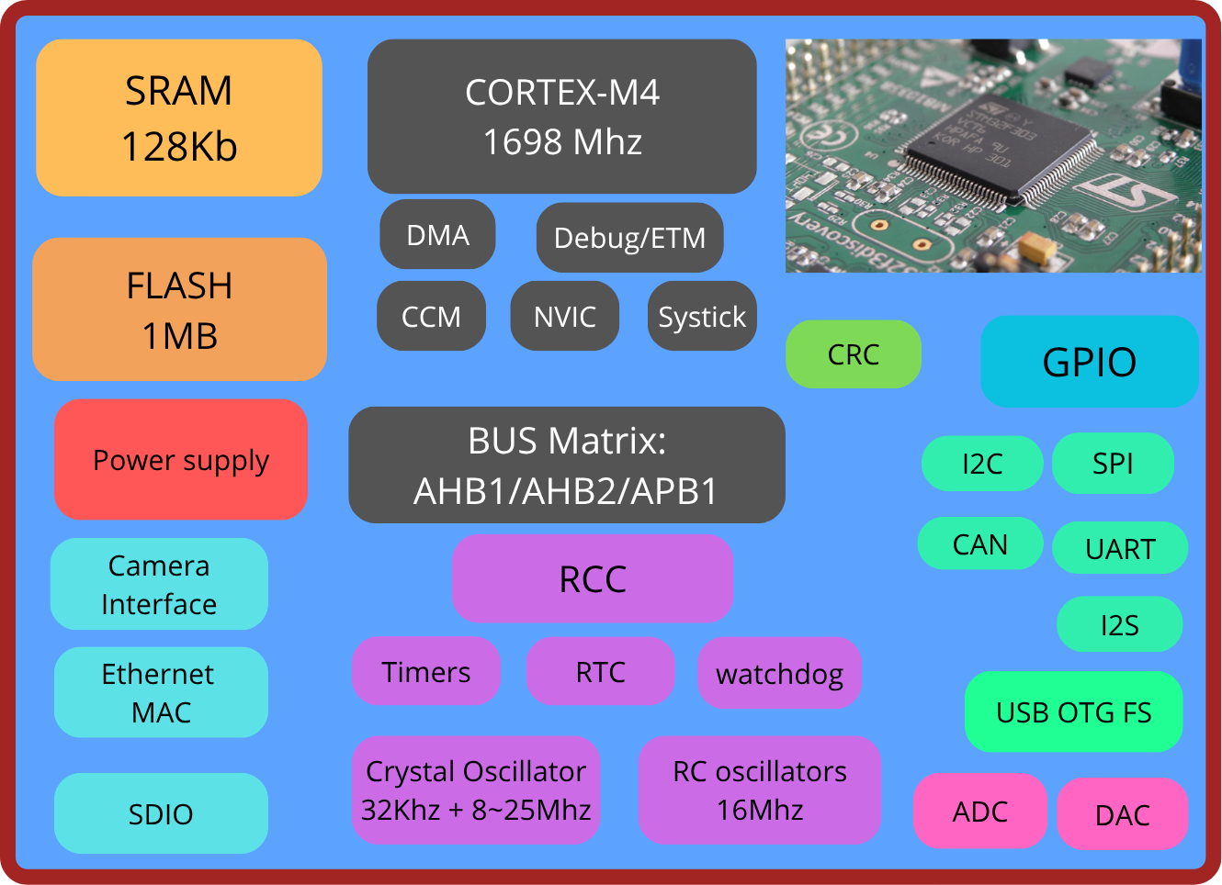
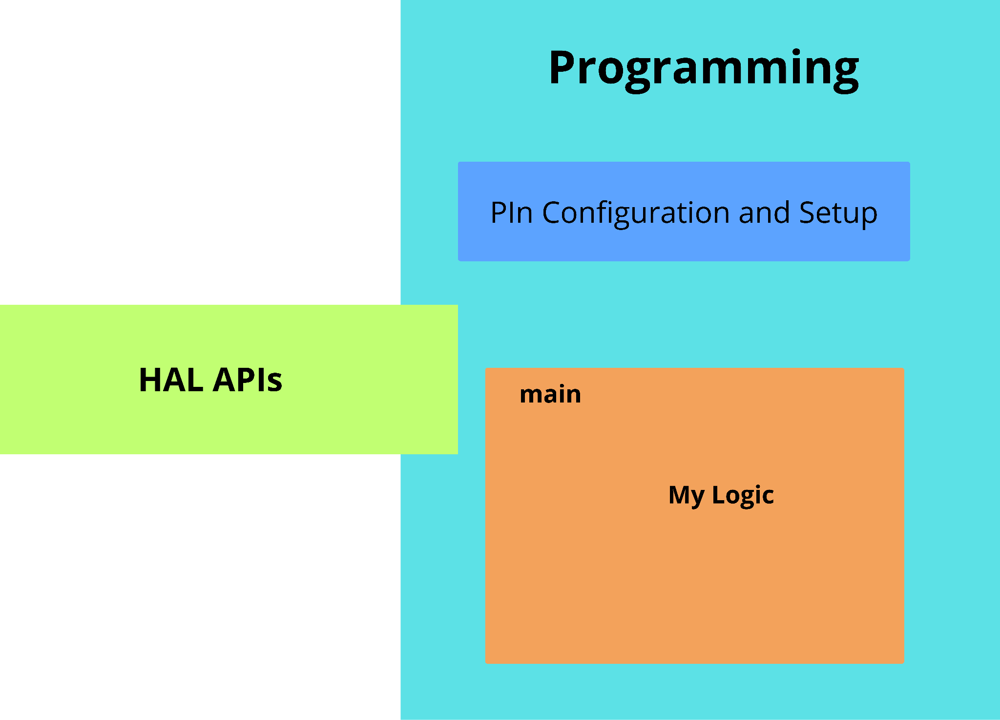
Programming: HAL

Slide 29
Programming: Pin Configuration
Enable BUS Clock for GPIO
GPIO Configuration
Main Program

Slide 30
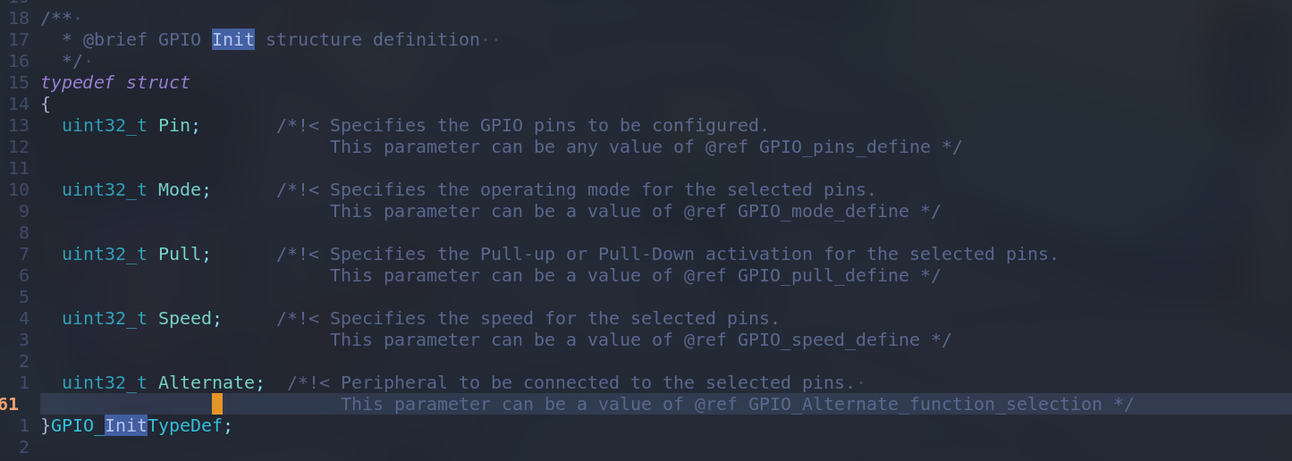
HAL:
GPIO InitStruct
I

Slide 31
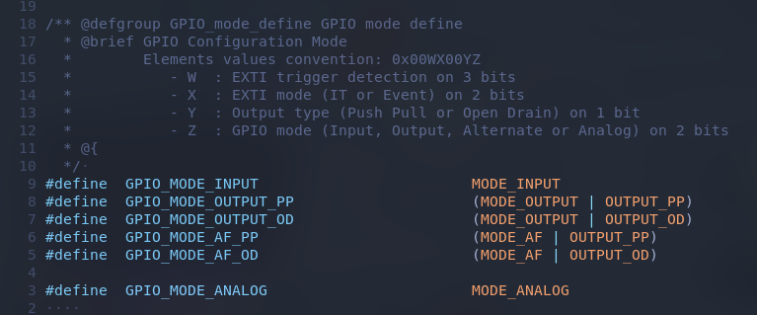
HAL:
GPIO Mode

Slide 32
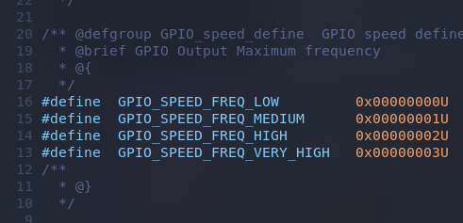
HAL:
GPIO Speed

Slide 33
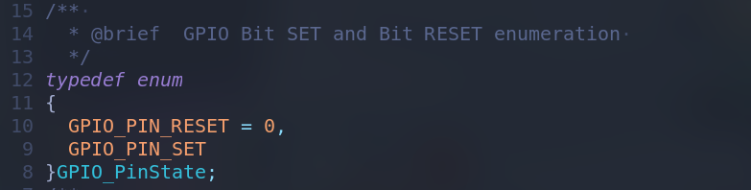
HAL:
GPIO Pin state
I

Slide 34
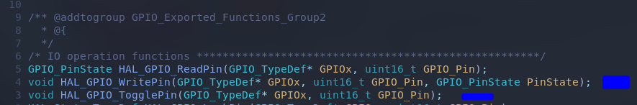
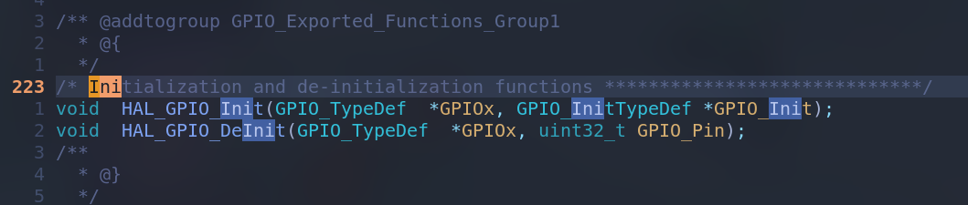
HAL GPIO APIs:
HAL function
I

Slide 35
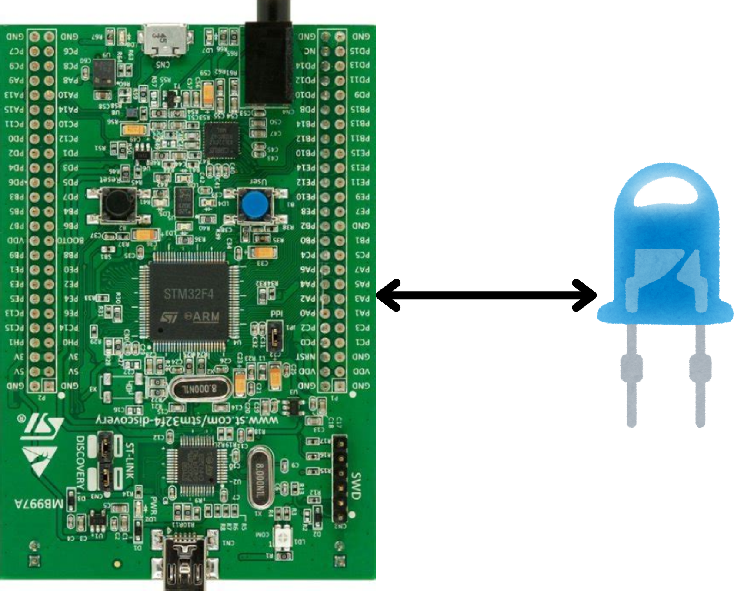
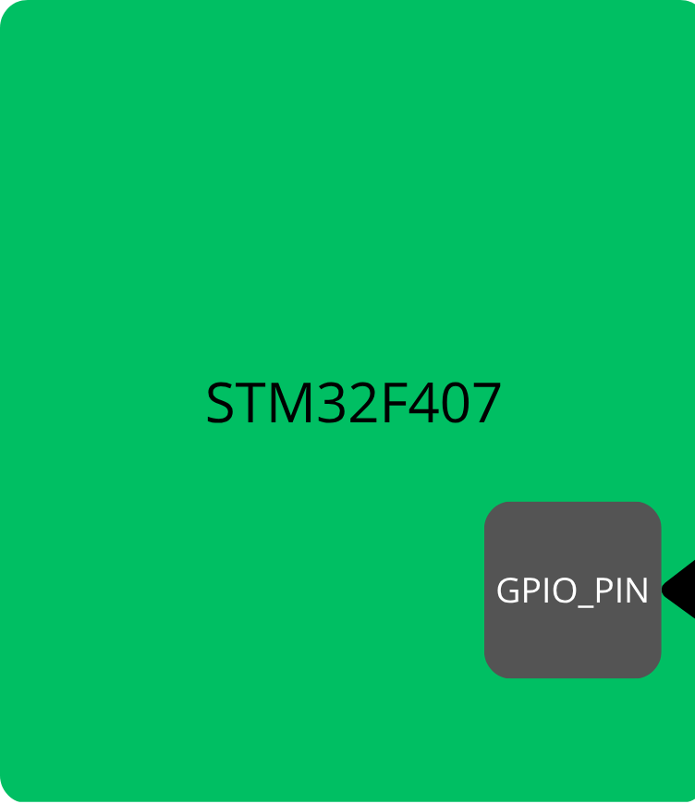
GPIO output STM32 and HAL: blinking an LED:
Toggling an LED
GPIOD
PIN12

Slide 36
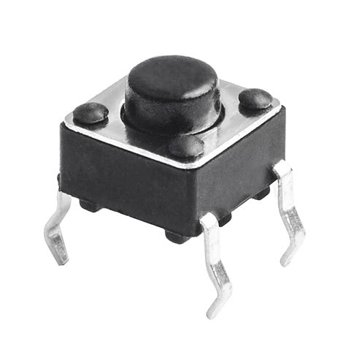
GPIO Input STM32 and HAL: Button
Reading button state
GPIOA
PIN0

Slide 37
Thank You

